Slide 1
Rockbuster Stealth LLC Sales Analysis
Matthew Tsubota

Slide 2
Introduction
Company Profile:
Rockbuster LLC is a movie rental company with stores all over the world.
Motivation:
Rockbuster is facing stiff competition from streaming services such as Netflix and Hulu. As a result, Rockbuster’s management team is planning to use its existing movie licenses to launch an online video rental service to keep pace with its rival.
Objective:
Create an action plan designed to assist Rockbuster to stay competitive, through an online video rental service.

Slide 3
Background Information
Rockbuster’s Average Rental Duration | Days
Average Rental Duration | 5 Days
Maximum Rental Duration | 7 Days
Minimum Rental Duration | 3 Days

Slide 4
What will we cover?
Revenue
Top Genre
Top customers
Least popular movies
Conclusion and Suggestions

Slide 5
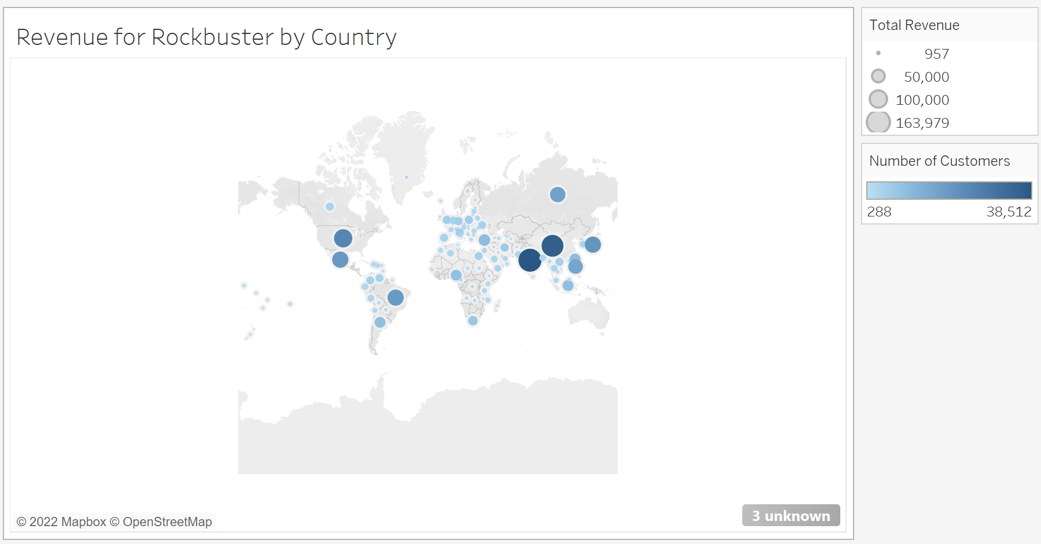
Revenue by Country
Based off of the map we see that Rockbuster has generated revenue from numerous different regions around the world.

Slide 6
But which countries actually supplied the most revenue?
Lets dig deeper

Slide 7
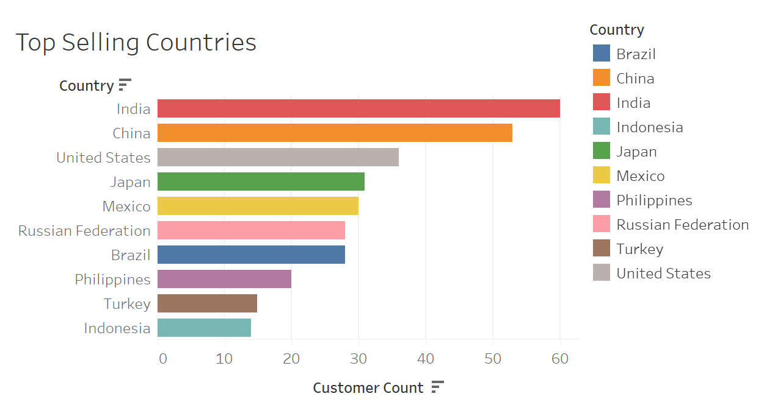
Sales By Country
Based off of this bar graph, in 2006, Rockbuster’s revenue came from what is known as the developing world.
This is how Rockbuster has generated income from the entire world.

Slide 8
But what brings in all of these customers to Rockbuster?
Time to explore

Slide 9
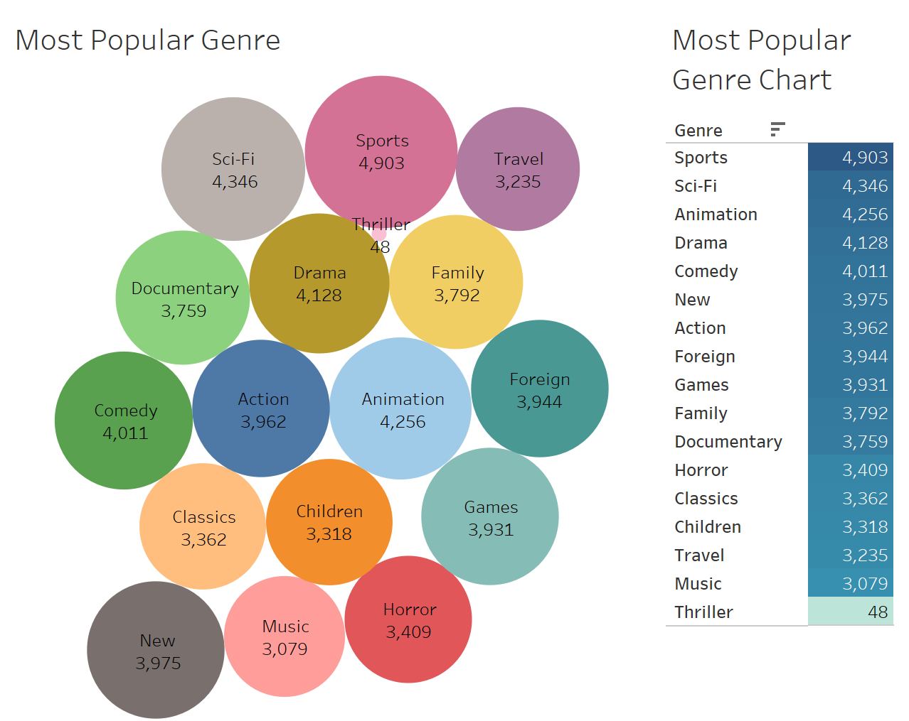
What is the most popular movie genre?
Based off of the data, we see that customer count based off of the genre have indicated the sales revenue.
In the future, Rockbuster can forecast an attribute such as movie Genre to drive additional sales and increase revenue.

Slide 10
How much did the best movie bring in?
Let’s Take a look

Slide 11
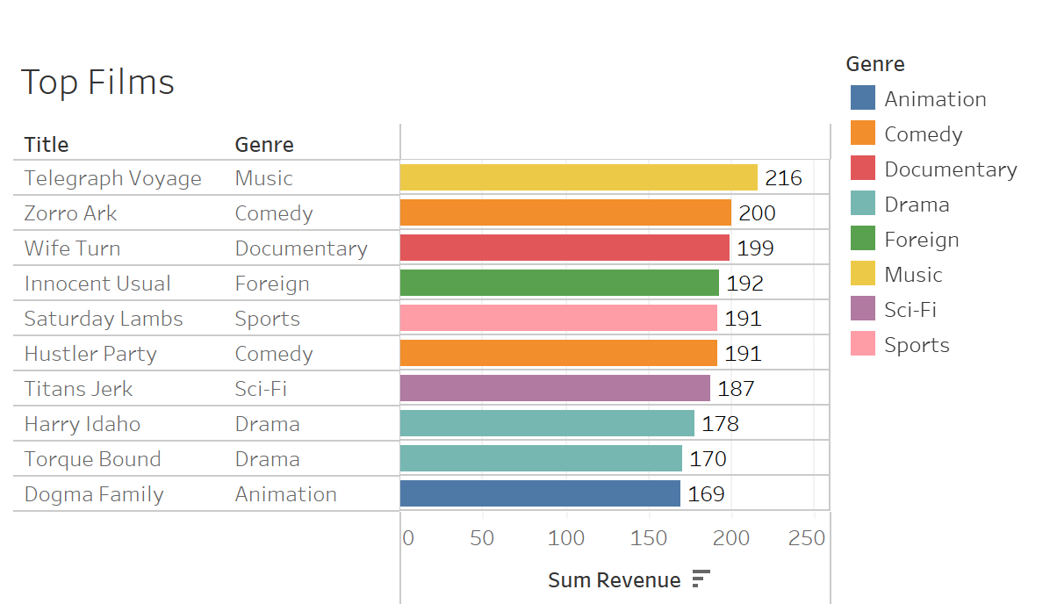
Top Films by Genre
Based on the data collected, it can help Rockbuster create better pricing strategies that will yield optimal profits and increase sales.

Slide 12
Who really brings in the most revenue?
Let’s be specific on this subject

Slide 13
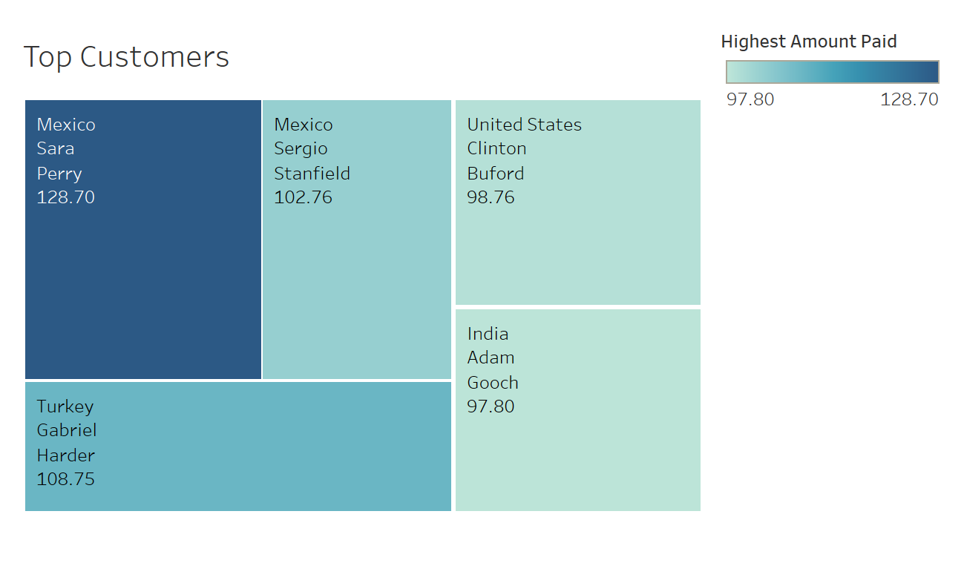
Which customers brought in the most revenue for Rockbuster?
Comparing the number of payments with other customers’ payments in other countries, there is not a significant difference in payments.
Based on the initial findings, the Rockbuster sales are highest in the top 10 countries where customers are paying the higher amounts.

Slide 14
Conclusion
Based off this report, we have discovered that Rockbuster LLC going global has been a benefit.
We have narrowed down which countries have developed the greatest amount of revenue for Rockbuster Stealth.
After we identified what was the most popular genre based on popularity by customer viewership.
Based on the same data we identified which movies were the most popular based on by genre.
Through the discovery of the most popular we found out how much revenue was being brought in based off of popularity.

Slide 15
Suggestions
Based off the Top Customers graph, perhaps we could develop a loyalty scheme, where customers are rewarded for the more they spend, through a points system, discounts and privileged benefits.
Based off the Genre graph, perhaps the advertisement department could create more ad campaigns for specific sets of movies for a specific set of customers based on their movie choices.
We could also promote movies in languages other than English, particularly in Asian languages (Hindi, Japanese, Chinese, Korean).

Slide 16
Tableau URL
https://public.tableau.com/app/profile/matt.tsubota/viz/RocbusterStealthLLC/RockbusterStory

